Slide 1
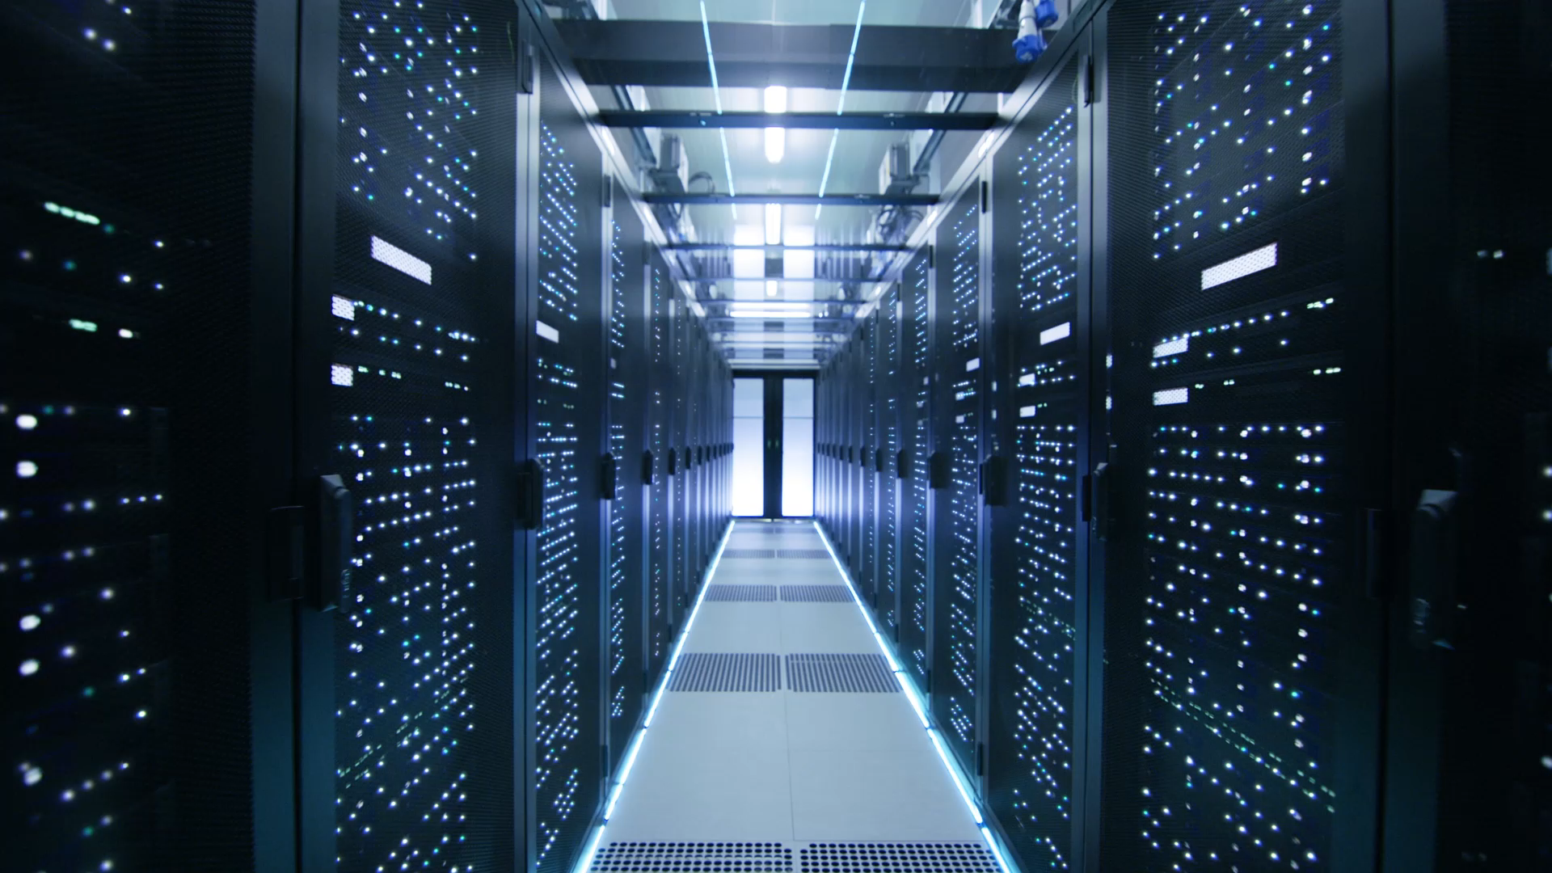

WEARABLE COMPUTING

Slide 2

Team Member
Deep Sureja(20BECE30255)
Dhruvin Vachhani (20BECE30271)
Jash Umretiya (20BECE30270)
Hitarth Upadhyay (20BECE30286)
Guided By : Dr. Lokesh Gagnani

Slide 3
Discussion outline:
Introduction
Definition & Its meaning
Evolution
Characteristics Of Wearable Computing
History Of Wearable Computing
Application area
Pros and Cons
Future Of Wearable Computing
Sixth-sense Wearable computing
Conclusion

Slide 4
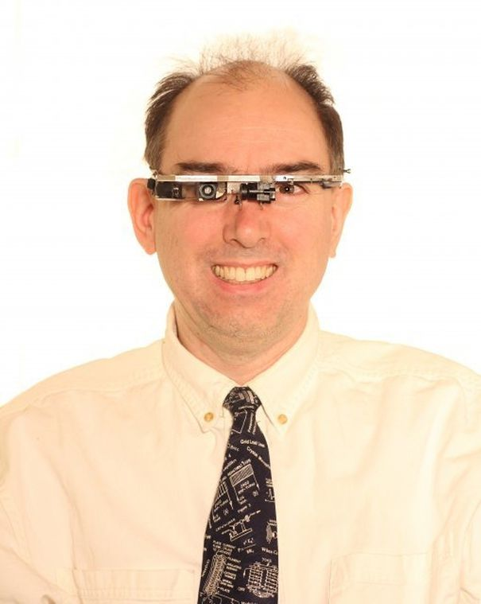
Introduction
A wearable computer, also known as a wearable or body-borne computer, is a computing device worn on the body.
It was invented by Steve Mann in the 1970s. The wearable computer was invented by Steve Mann, a professor at the University of Toronto.
They may also be integrated into everyday objects that are constantly worn on the body, like a wrist watch or a hands-free cell phone.
Wearable computers are usually either integrated in to the user's clothing or can be attached to the body through some other means, like a wristband.
Steve Mann

Slide 5
Definition & Its meaning
A wearable computer is any small technological device capable of storing and processing data that can be worn on the body.
Wearable computers are designed for accessibility and convenience, as well as improvements to workplaces by making information quickly and readily available to the wearer.
Common examples of how wearables are worn include on wrists as watches or jewellery, around necks similarly to a lanyard or necklace, on the user's head, in the user's shoe or carried in a bag.

Slide 6
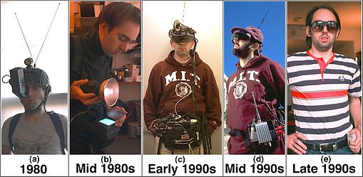
Evolution Of wearable computing
Evolution of Steve Mann's Wear Comp wearable computer from backpack based systems of the 1980s to his current covert systems.
In 1981, Steve Mann designed a backpack-mounted computer to control cameras and other photographic equipment.

Slide 7
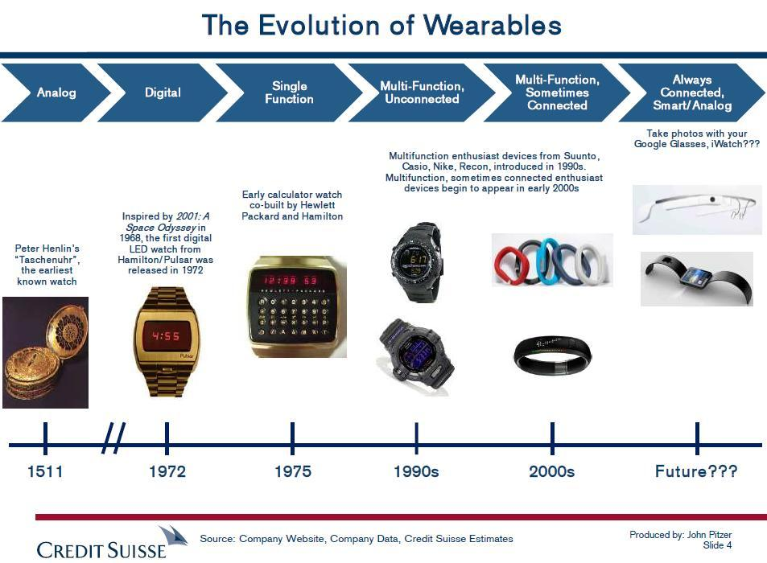

Slide 8
Characteristics Of Wearable Computing
There are six informational flow paths associated with this new human--machine synergy.
Unmonopolizing (of the user's attention):-Wearable computer does not cut you off from the outside world such as a virtual reality game or the like.
UNRESTRICTIVE: to the user: ambulatory, mobile, roving, you can do other things while using it e.g. you can type while jogging, etc.
OBSERVABLE by the user: It can get your attention continuously if you want it to.
CONTROLLABLE by the user: Responsive. You can grab control of it at any time you wish.
ATTENTIVE to the environment: Environmentally aware, multimodal, multisensory.
COMMUNICATIVE to others: Can be used as a communications medium when you want it to

Slide 9
History Of Wearable Computing 1500-2010
Queen Elizabeth I of England received a watch from Robert Dudley in 1571, as a New Year present; it may have been worn on the forearm rather than the wrist. She also possessed a 'finger-watch' set in a ring, with an alarm that prodded her finger
In 1600s The Qing Dynasty saw the introduction of a fully functional abacus on a ring, which could be used while it was being worn.
In 1961, mathematicians Edward O. Thorp and Claude Shannon built some computerized timing devices to help them win at a game of roulette.

Slide 10
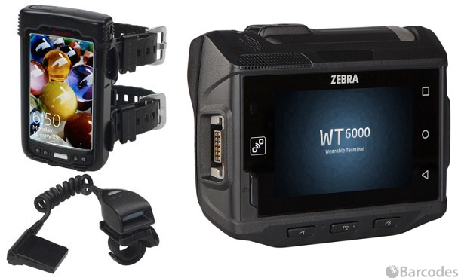
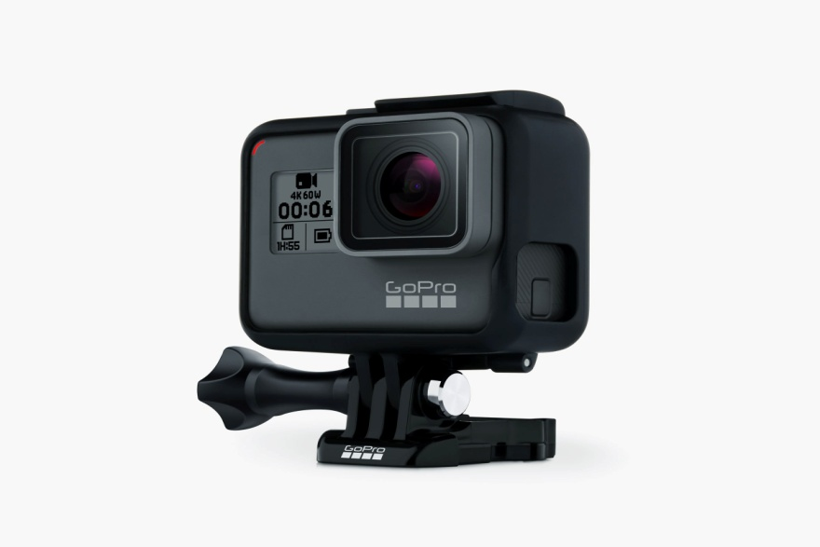
History Of Wearable Computing 1500-2010
In 2000 Dr. Bruce H Thomas and Dr. Wayne Piekarski developed the Tinmith wearable computer system to support augmented reality. This work was first published internationally in 2000 at the ISWC conference.
In 2010 GoPro released their first product, the GoPro HERO 35mm, which began a successful franchise of wearable cameras. The cameras can be worn atop the head or around the wrist and are shock and waterproof. GoPro cameras are used by many athletes and extreme sports enthusiasts.

Slide 11
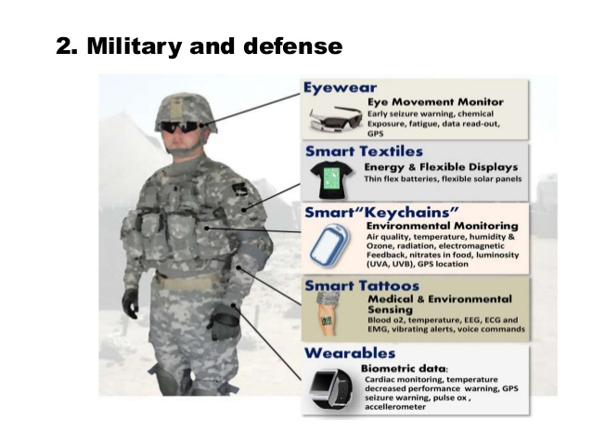
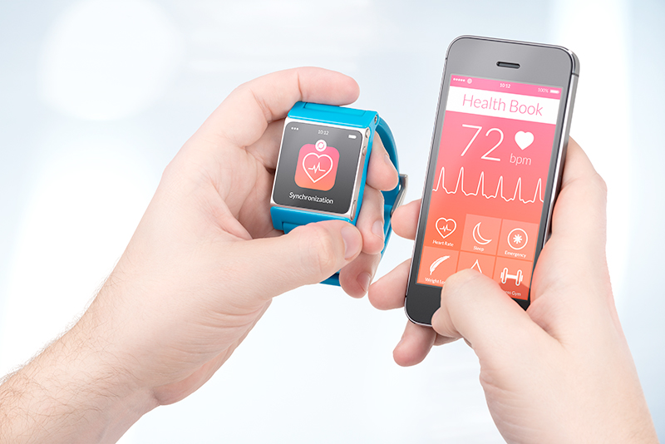
Application area
Military Field:-The use of wearable computers in the military has grown for applications such as surveillance, location tracking and equipment repair.
Healthcare Field:-Wearable technology in healthcare includes electronic devices that consumers can wear, like Fitbits and smartwatches, and are designed to collect the data of users' personal health and exercise.

Slide 12
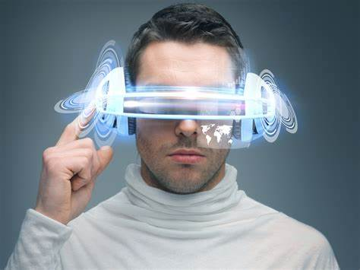
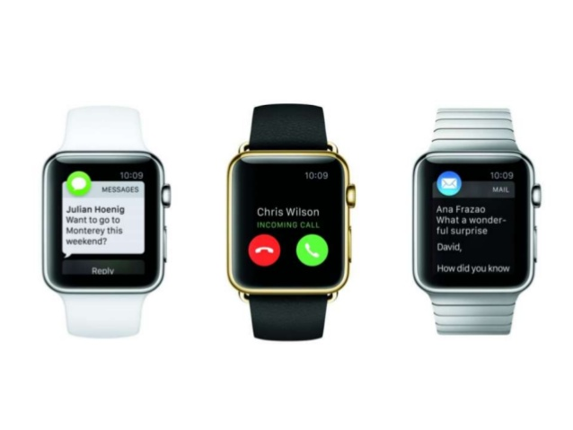
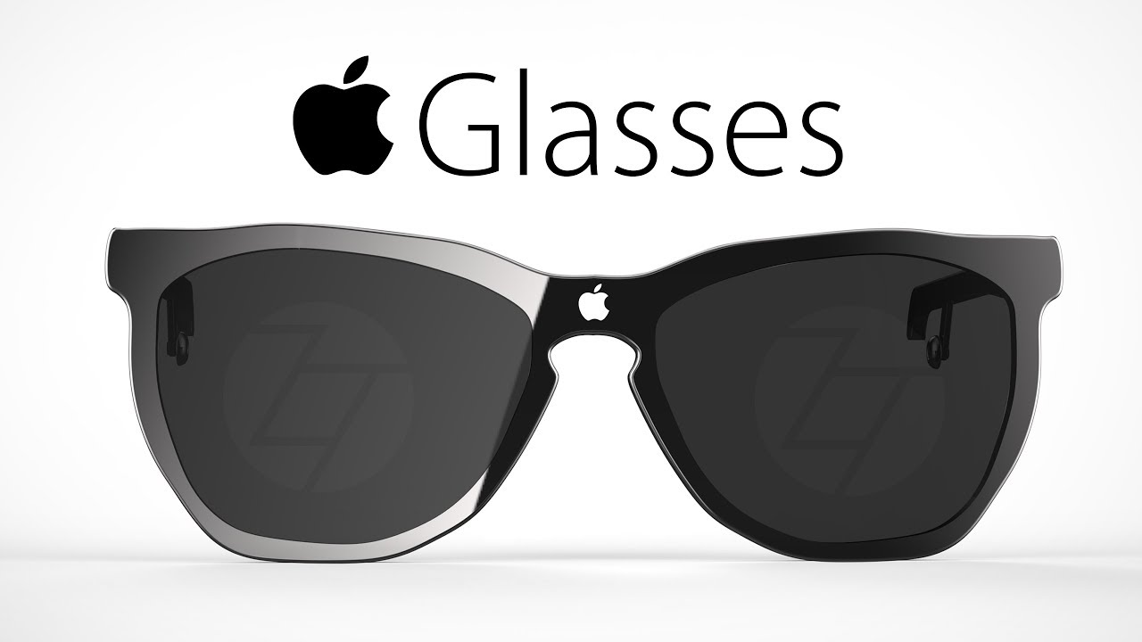
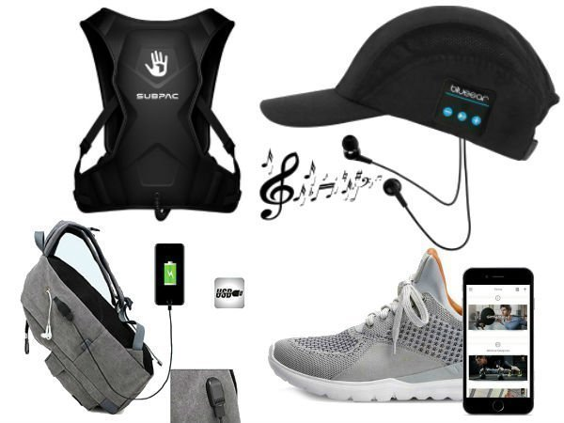
Other Applications Areas
Face Recognition
Finger Tracking
Visual Filter
Navigation
Wearable computer in a Wrist Watch
Wearable computer in Shoe
Health monitoring Wearable’s
Smart Glasses

Slide 13
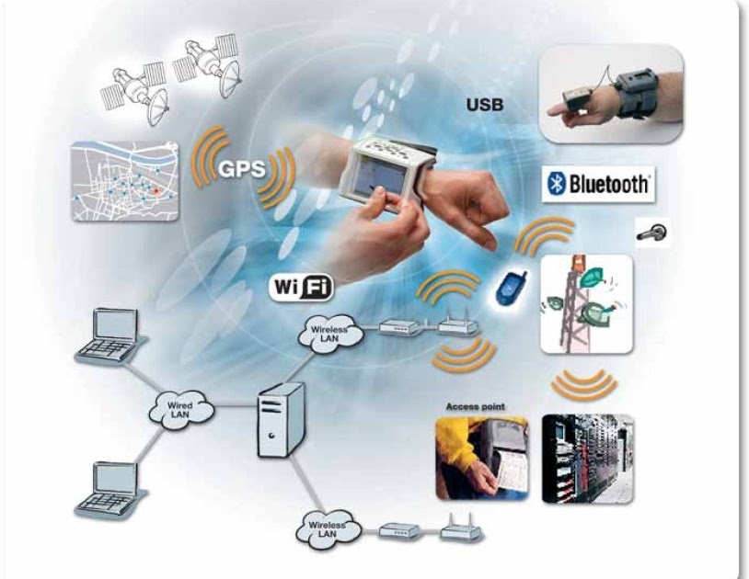
Advantages
Mobility :-Imagine being able to carry all the capabilities of your desktop as you work, wherever you do.
Connectivity:- All the information resources of the organization are at your fingertips, instantly. you are always in touch.
Efficiency:- No more going back to the office to access or input needed data. No more duplication of effort.
Productivity:- Add it all up, and you are looking at increased organizational productivity and a bigger bottom line.
Flexibility:-Can be used by anyone at any point of time at any place.

Slide 14
Disadvantages
Equipment can be heavy
Expensive
Some wearable computers can consist of a lot of wiring
Can cause irritation in heat
Side-effect such as headaches
Wearable computer can invade privacy
Smaller space of storage
Network bandwidth

Slide 15
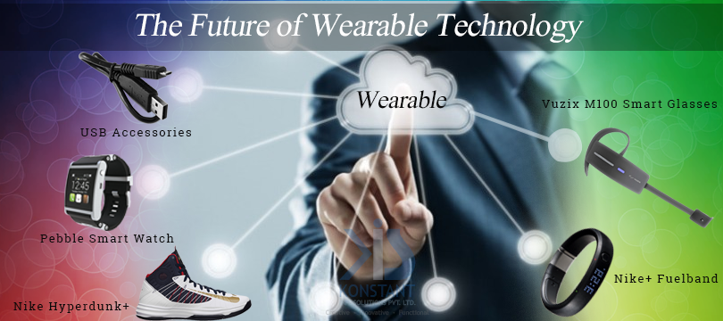
Future Of Wearable Computing
The future of wearable technology Smartwatches, fitness trackers, and VR/AR headsets have become more and more prevalent in our society over the past several years.
It's predicted that wearables will only continue to grow in popularity, so naturally companies are finding new and innovative ways to apply them to our everyday lives.
The future of wearable tech lies in seamless integration.

Slide 16
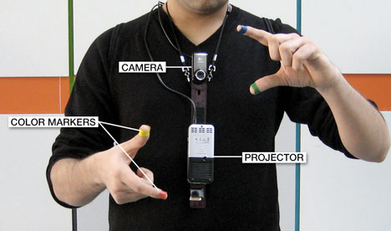
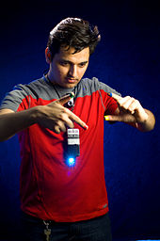
Sixth-sense Wearable computing
Sixth Sense is motion of hand or the body system developed at MIT Media Lab by Steve Mann in 1994 and 1997 and 1998 and further developed by Pranav Mistry in 2009, both of whom developed both hardware and software for both headwork and neck worn versions of it.
Pranav Mistry wearing a similar device in 2012, which he and Maes and Chang named "WUW", for Wear your World.

Slide 17
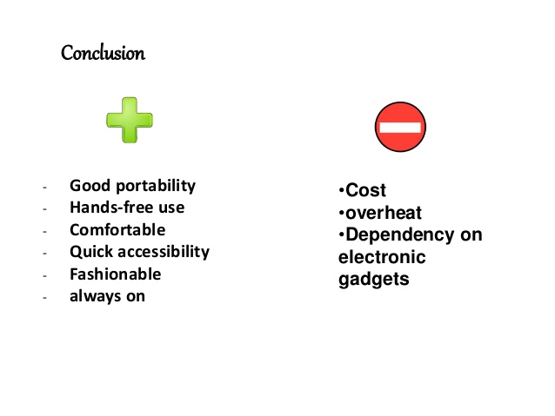

Slide 18


